Slide 1
Figure Dev Management
11/25/2020
Feel free to add comments and suggestions in this ppt

Slide 2
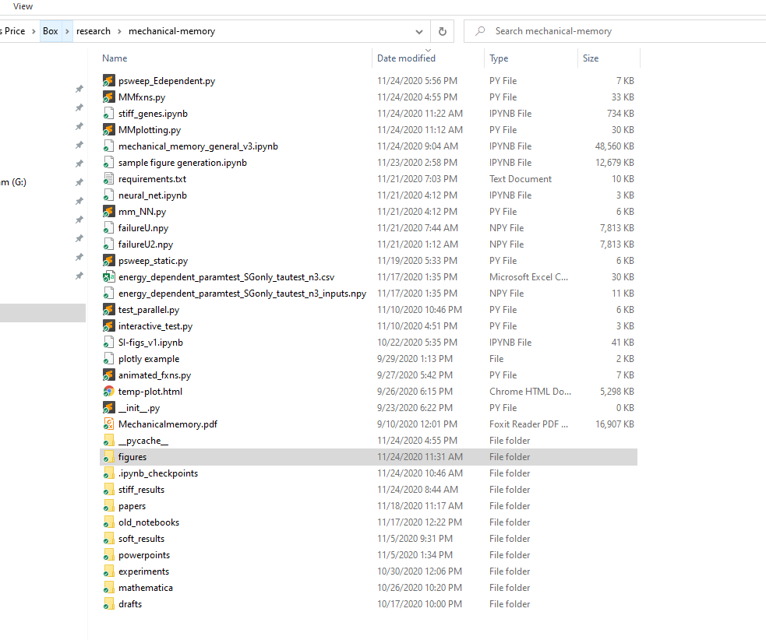
Top level project folder (messy, sorry!)
Cloud storage
Figures folder
Data, code
Where manuscript drafts will go

Slide 3
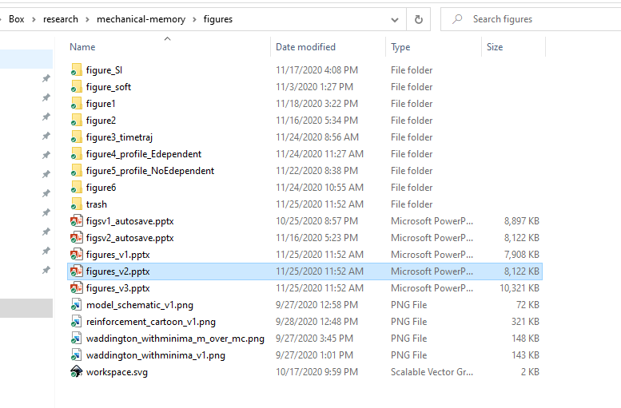
Separate folder for each figure
Instead of deleting
Keep all versions

Slide 4
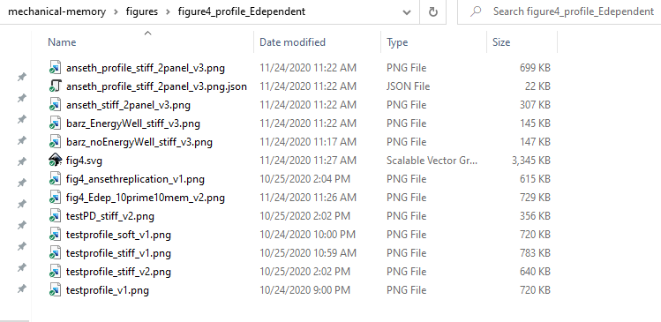
Relevant code saves plots directly to this folder
Save a copy of the parameters used to generate the plot with the same name, so you can quickly reproduce.
File for assembling components into full figure

Slide 5
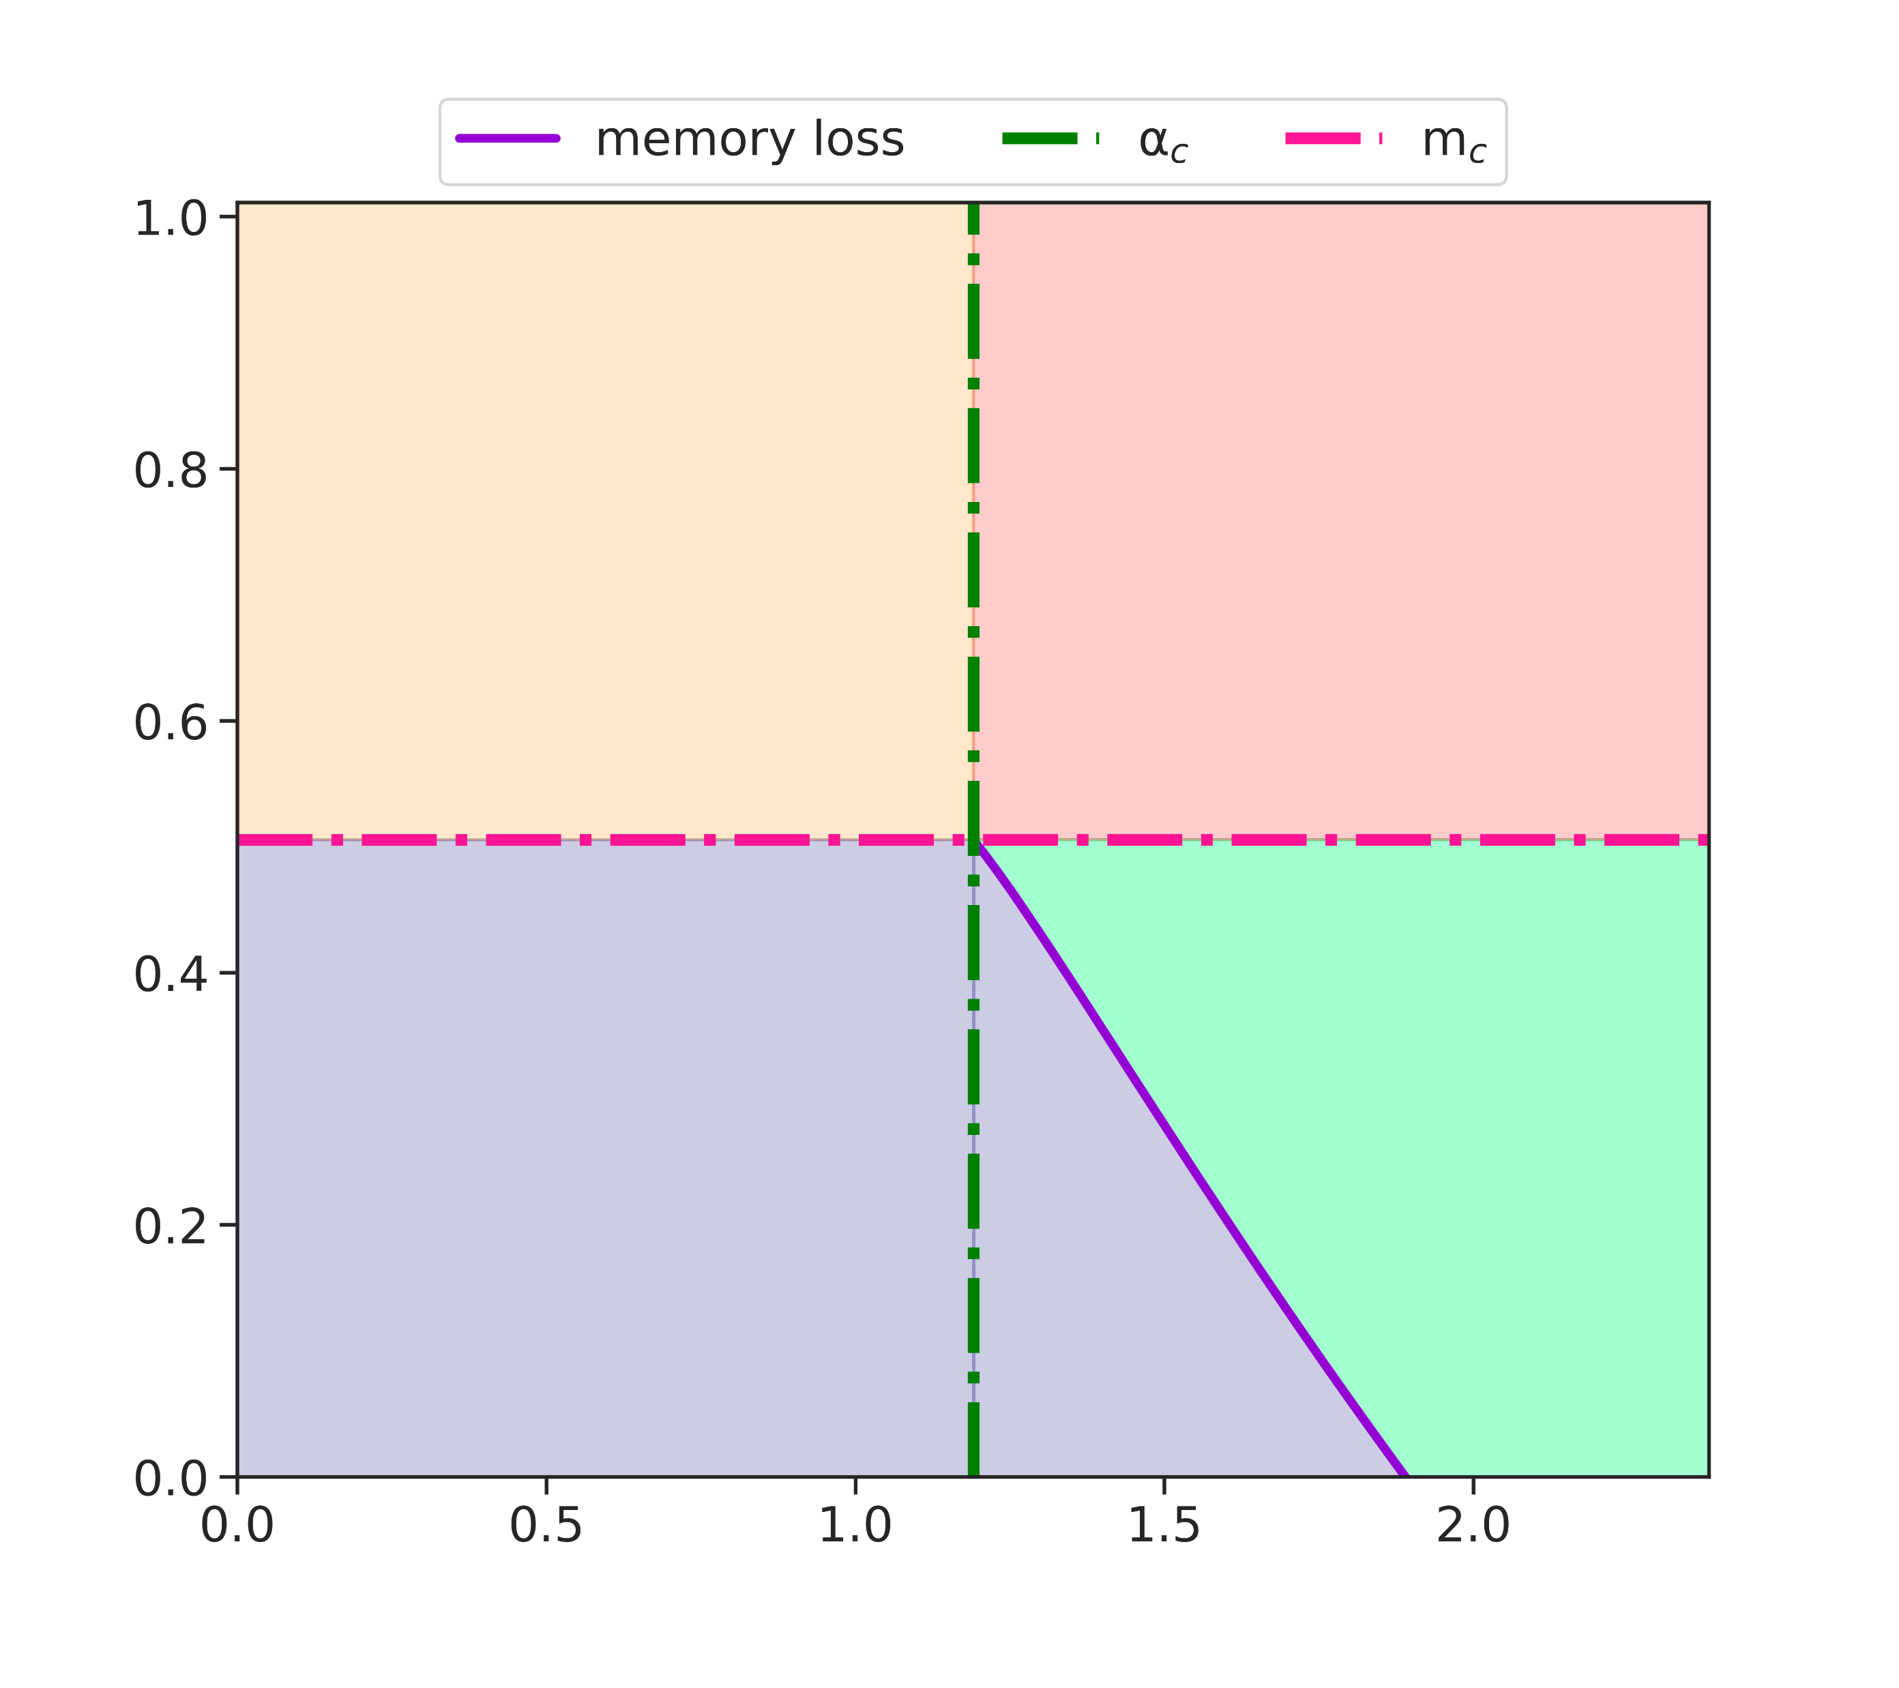
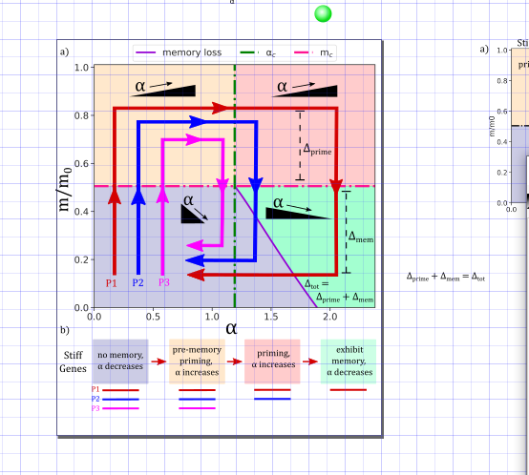
Canvas size matches approx. journal figure size requirements
Input from code – additional annotations added in graphics editor
Old version moved to the side

